Slide 1
Chapter 8
External Environments and Accountability of Schools

Slide 2
Selected External Influences and
Constituencies for School Districts
Political and
Legal Patterns
Demographic
Characteristics
Taxpayers
Parents
Unions
Societal
Conditions
Cultural
Values
School
District
Colleges/
Universities
Regulatory
Agencies
Educational
Associations
Legislatures
Accrediting
Agencies
Economic and
Market Forces
Information
Technologies

Slide 3
Two Perspectives on Environments
Resource-Dependence Perspective
  Environmental resources: Fiscal, Personnel, Information, Products
  Environmental resources: Simple or Complex
  Availability of resources: Scarce to Munificence
  Dependence: Need and Availability
  Decision makers: View the environment as a place to gain scarce resources for the organization
Institutional Perspective
  Limited emphasis on goals, effectiveness, and efficiency
  Schools: Constrained by other institutions of society
  Administrators: Constrained by broader institutions

Slide 4
Resource-Dependence Perspective
Dependence is characterized as the extent of the need for a resource and its availability.
It is directly related to the need for resources controlled by other organizations.
Suppliers gain power to decide whether schools get resources they need and determine if the schools can use the resources the way they want.
If organizations are unable to generate resources internally, they must enter into external exchanges which may consume vital resources and/or demand changes from the organization. (Pfeffer, 1982, 1997)

Slide 5
Resource-Dependence Perspective
Resource Continuum
Scarcity
Competition for resources is fierce
Zero-sum game
Limited to basic academic and extracurricular programming
Munificence
Survival is easy
Pursue wide-ranging goals
Abundant curricular and extracurricular programs

Slide 6
Administering Task Environments
  Uncertainty and dependency threaten or constrain autonomy and drive change; thus, organizations must cope.
  Coping Strategies:
  Buffering
  Planning and forecasting
  Boundary spanning
  Adjusting operations
  Accommodating structure

Slide 7
The Environment-Structure Fit
  Change the Structure to fit the Environment
  If the environment is stable, a mechanistic structure is an effective accommodation.
  If the environment is unstable, then an organic structure is the better fit
  If the environment is stable and the organizational structure is organic, a dysfunctional flexibility emerges.
  If the environment is unstable and the structure is mechanistic, a dysfunctional rigidity is produced.

Slide 8
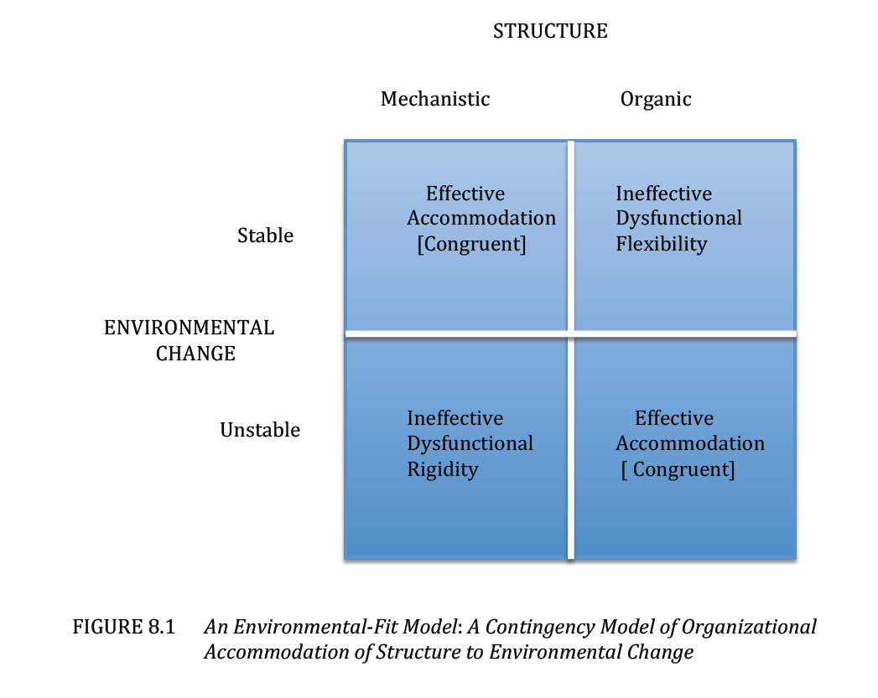
Accommodating Structure to Environmental Change

Slide 9
Administering Task Environments
Inter-organizational coping strategies
  Partnerships
  Cooptation
  Political lobbying
  Pooling resources

Slide 10
Institutional Perspective
Institutions are more or less agreed-upon set of rules that carry meaning for and determine the actions of some population of actors.
Institutional environments are symbolic and cultural in nature.
Important ideas include conformity, diversity, and stability

Slide 11
Institutional Perspective
Types of Conformity
  Coercive – pressures of government mandates and inducements
  Imitative – adopting standard responses from other sources to reduce uncertainty and gain legitimacy
  Normative – professional standards and codes are spread across organizations

Slide 12
Institutional Perspective
Stabilizing forces in education:
  Centralized government, professional associations, and coalitions standardize operating procedures and provide stability (Meyer & Rowan, 1977)
  Environmental demands, characteristics of inputs and outputs, technical processes brought under jurisdiction of institutional meanings and control
  Support guaranteed by agreements rather than dependent upon performance.

Slide 13
Administering Institutional Environments
Buffering strategies
  Decoupling
  Managing the image
Boundary-spanning strategies
  Categorical conformity
  Structural conformity
  Procedural conformity

Slide 14
Accountability
Accountability plans generally include three components:
  • Standards to identify the subject matter knowledge and skills to be learned.
  • Tests aligned with the standards.
  • Consequences of differing levels of goal attainment.

Slide 15
Accountability and Reform
The drive for accountability is based on three underlying principles:
  • Schools should be held accountable for higher standards of performance.
  • Schools should be provided assistance to build their capacities for delivering improved education.
  • Schools must increase the quality and quantity of their performance outcomes, especially student achievement.

Slide 16
Federal Reform Initiatives
The No Child Left Behind Act
AYP—Academic Yearly Progress
EBP—Evidence-Based Practice
Scientifically-Based Research to inform practice
Race to the Top
Adopting Standards
Building Data Systems
Recruiting and developing effective teachers and principals
Turning around our lowest achieving schools.

Slide 17
Campbell’s Law
The more any quantitative social indicator is used for social decision making, the more it will distort and corrupt the very social processes it is intended to monitor.
Early-warning testing in elementary schools may push out students who are likely to fail the test because both the school and students believe that these students are a poor bet for finishing high school. This is good example of looking good but failing.
If accountability practices are to be effective, they must shun short-term successes in favor of rigorous systemic changes that actually improve schools.

Slide 18
Practical Imperatives
Keep organizational structures flexible: It is imperative to respond quickly to environmental constraints.
Nurture healthy relations with local groups and agencies: Parental groups and local organizations are important aspects of the immediate environment.
Engage the environment: It presents both constraints and opportunities.
Develop internal and external coping strategies: Buffering and bridging are two general strategies to cope positively with the external environment.
Recognize that schools are institutions: Schools mirror the norms, values, and ideology of the broader society.
Develop fair accountability systems for teachers: Accountability is an organizational reality.
Ensure that tests are aligned with standards: Clear and rational alignment limits conflict and improves success.
Be open to constructive change: Change and reform are integral parts of contemporary schooling.
Beware of the dysfunctional consequences of high-stakes testing: A focus on standardized test scores can encourage cheating and limit poor students’ prospects for success.
Seek abstract resources such as neighborhood affiliations or school culture: Abstract resources are more potent than simple ones in school improvement.

